Slide 1

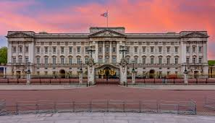
Welcome to
Buckingham Palace Class
Reception - EYFS

Slide 2


Working in Partnership
At Bruce Grove we strongly believe in working together with parents to ensure all children are happy, safe and successful learners.
I am available after school on these days: Monday, Wednesday and Thursday
Alternatively, please leave a message with the office for a call back if you have any concerns.

Slide 3
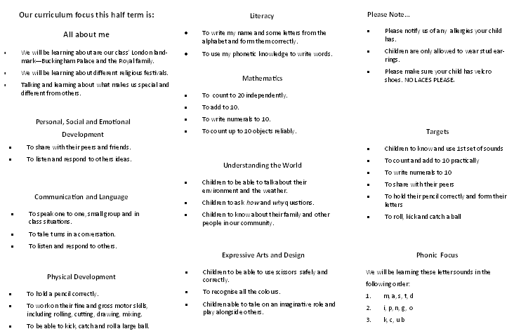
Learning Focus for this term…

Slide 4
Days to note…
Buckingham Palace Class Schedule
Monday
Tuesday
Wednesday | PE
Thursday
Friday | Homework – Not yet
Reading books will be changed each week.
Please share and read a book with your child for 10 minutes each day if possible.

Slide 5
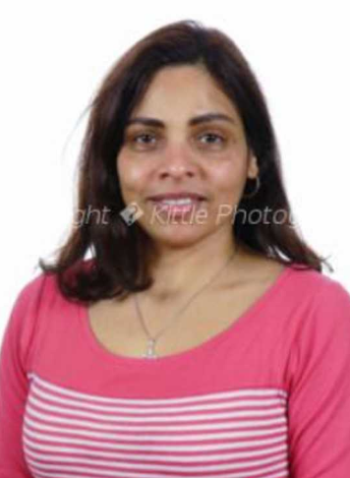
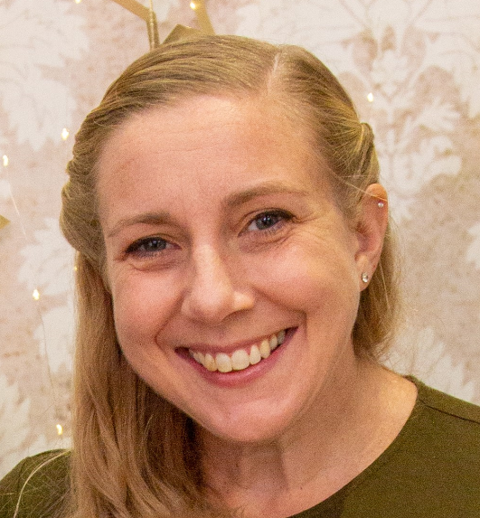
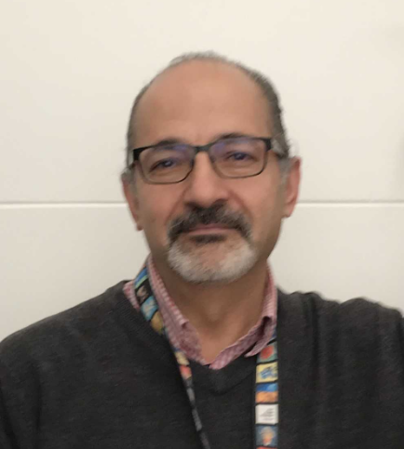
Meet the Team:
Joaquina Alvares
Emma Quare
Monday - Thursday
Majid Ghorbanian
Fridays

Slide 6

Phonics : RMI
Children will learn the sounds not in alphabetical order.
Starting with:
m, a, s, t, d
This means they can instantly begin to sound out and blend words. (Green words)
e.g. m a t
Alongside they will learn red words or tricky words, that cannot be sounded out
e.g. I, the, my

Slide 7
What can we do to help at home?
Use pure sounds rather than letter names.
Use Fred Talk to help your child to read and spell words.
Listen to your child read their Storybook every day.
Watch the Virtual Classroom films together.
Read stories to your child every day.
Ruth Miskin Parents’ Page:
https://www.ruthmiskin.com/parents/
Ruth Miskin Facebook:
https://www.facebook.com/miskin.education
Free e-books for home reading:
http://www.oxfordowl.co.uk/Reading/

Slide 8
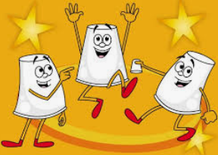
Maths Makes Sense
This is a scheme we use to support our teaching of maths.
We will:
count various objects
learn to recognise and write our numbers to 20
Our number bonds to 10 e.g. 1 + 9
2D and 3D shapes
Alongside our teaching Maths Makes Sense uses specific language and teaches through the use of cups and actions.

Slide 9

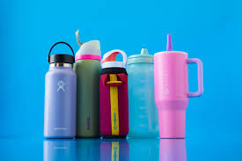

Things to note…
PE – On Wednesdays children come to school in their PE kit
Please bring a water bottle each day
Please bring a book bag each day
We are currently completing the Government Reception Baseline, children may say they have completed some English or maths activities on a tablet, this is them completing the baseline.
Cooking money 50p a week or £6 for the term.

Slide 10
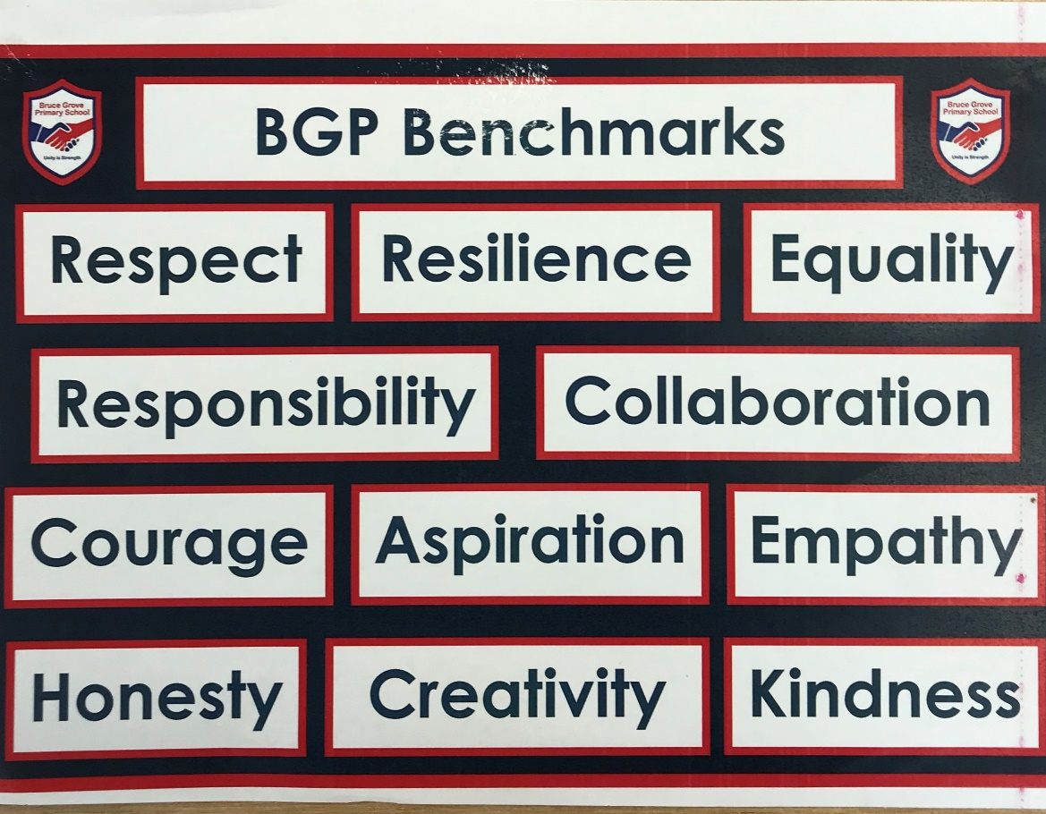
Our School Benchmarks
Notes:
Our school benchmarks underpin everything we do. We expect children to follow these at all times. In our class we have devised a set of class rules these are... Next slide.

Slide 11
Our School Rules
We are respectful and courteous to everyone
We are prepared to learn and aspire to achieve
We work hard – We are resilient and positive
We are honest – We always tell the truth
We listen without interrupting
We are responsible and look after property

Slide 12
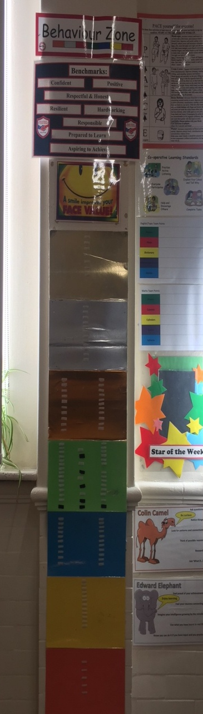
Behaviour Zones
At Bruce Grove, we use the colour zones.
We encourage all children to follow the school benchmarks and class rules.
Every day your child will start on green.
We reward children by going up the zones.
When a child gets 3 gold badges they go to Ms George to receive a special prize and a text message is sent home.

Slide 13



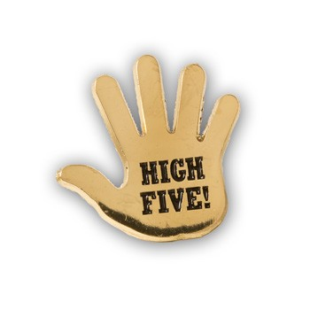


Other Rewards
Your child will be praised, smiled at, get a thumbs up or a high five!
Your child will be given Smiley Faces/Merits.
Your child will get a positive text message home.
Your child will be sent to a senior member of staff to be praised
/ given a sticker.
Your child will get a special mention in Celebration Assembly.
Your child will be ‘Star of the Week’.
Your child will get a Green Badge for excellent lunchtime behaviour.
Your child will get rewards for three green badges.
Your child will get Extra House Points.
The winning teams get prizes each term.
Your child will get Marvellous movement stickers for moving around the
school nicely.
Your child will get prizes.

Slide 14

Negative Behaviours
Occasionally, we have to remind children of our class rules and the school benchmarks.
We always give a warning first.
If the negative behaviour continues then the child will go down the behaviour zones.
We always encourage them to change their behaviour so they can go back up the zones.

Slide 15
Yellow Letters
These are issued by the class teacher when your child has not been following the class rules and has ended the day on yellow.
We are always happy to discuss the reasons why with you.

Slide 16
Red Letter
Occasionally Ms. Etienne-Barnett and Mrs Finisterre will issue a red letter.
This is when the child has ended the day on red or demonstrated very poor behaviour in the classroom or playground.
The reason is always written on the letter and Ms. Etienne- Barnett or Mrs. Finisterre are happy to speak to you about this.

Slide 17

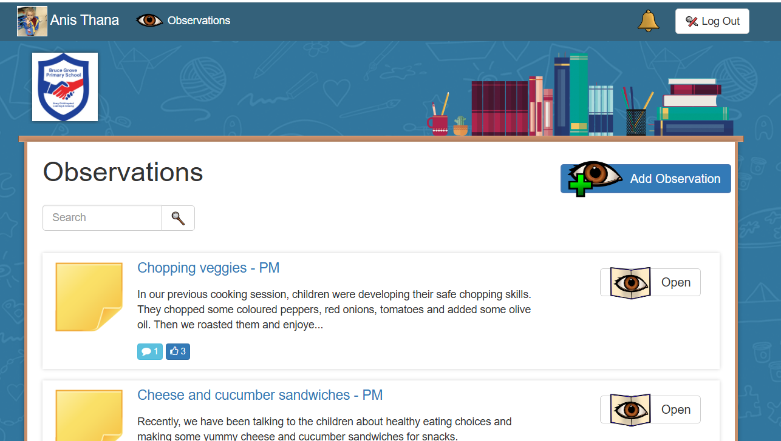
Tapestry
If you have not done so please complete the Tapestry agreement form.
You will receive an email asking you to log in and set up a password, this will be based upon your agreement form.
If you were in our Nursery please let us know if there is an email change.
Screen will look like
this when you log in.
Please feel free to comment on your child’s photos.
Please do not share group photos on any social media platforms

Slide 18

Google Classroom
This is where you will find:
Updates on what is happening in class
Online learning Links
Home learning links for individuals who cannot attend school.
https://www.brucegroveprimary.com/
How to login
Each child has a unique username and password to log on. Their username is made up of
• The first 4 letters of last name
• Your name initial
• A series of numbers
• Followed by @brucegroveprimary.com For example for a child in year three called Jane Smith, this would be smitj032@brucegroveprimary.com If you need help with this, please contact the school office.

Slide 19
Our Google Classroom Class Page
This is where you will find:
Updates on what is happening in class
Online learning Links
Home learning links for individuals who cannot attend school.
https://www.brucegroveprimary.com/

Slide 20
Any Questions?
Letters about free school lunches – this was eligibility for Pupil Premium, every child will receive a free school lunch whether they qualify for Pupil Premium or not.
Information about Tapestry, Google Classroom and RWI links will be sent out to you

